Slide 1

Insulin Therapy
&
Managing T1DM
Yousef Al Zahib, SBFM, ABFM, JBFM, KSUDF
Diabetes and Family Medicine Consultant

Slide 2

Audience Participation
Which of the following factors should be considered when choosing insulin therapy for a patient with diabetes?
  Dose of insulin needed
  Cost
  Ease of administration (vials versus pens)
  Frequency
  All of the above

Slide 3
Audience Participation
A 56-year-old man with T2DM is on metformin ER 2000 mg daily, insulin glargine U-300 at 50 units daily, and liraglutide 1.8 mg daily. His A1C is at goal of <7% with no hypoglycemia. Fasting and postprandial BG values are in range. Glargine U-300 is now out of stock and patient is being switched to insulin glargine U-100. What dose of insulin glargine U-100 do you recommend?
  50 units as there is a 1:1 conversion
  40 units of insulin glargine U-100
  60 units of insulin glargine U-100
  None of the above is correct

Slide 4
Objectives
Understand the role of insulin therapy in managing diabetes effectively.
Identify the different types of insulin and their mechanisms of action.
Describe the importance of personalized insulin regimens based on patient factors.
Compare and contrast the safety and efficacy of insulin formulations available in the market.
Calculate insulin dose conversion.
Apply evidence-based protocols for initiating and adjusting insulin therapy in T1DM.

Slide 5
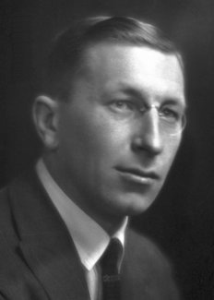
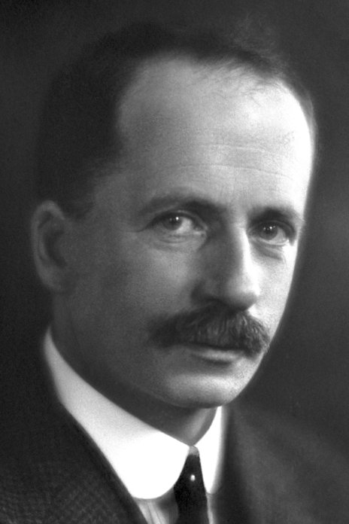
HISTORY & BACKGROUND
“Insulin does not belong to me, it belongs to the world.”
Discovered insulin in 1921 in pancreatic extracts of dogs
Frederick Banting
John Rickard

Slide 6
HISTORY & BACKGROUND
First insulin injection was given to a 14-year-old Leonard Thompson in January 22, 1922 in Toronto, Canada for the treatment of type 1 diabetes.
First injection caused an allergic reaction due to impurity
Second injection was successful
Continued to take insulin for ~13 more years before dying from pneumonia at age of around 26

Slide 7
Diabetes Spectrum and insulin use
TYPE 1
Other Specific Types
LADA*
Type 2
Insulin insufficiency/ deficiency
Surgical caused
Drug caused
Insulin deficiency Usually Immune-mediated
Insulin resistance
GDM

Slide 8
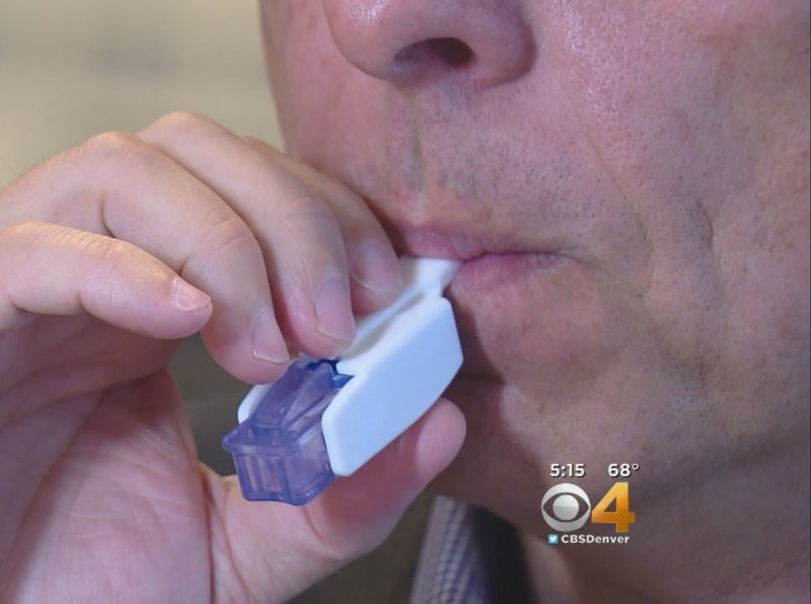
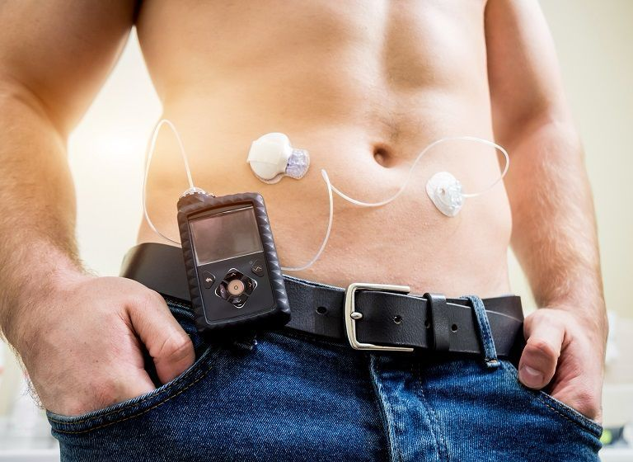
Insulin modes of delivery

Slide 9
Important factors when choosing Insulin
Type of diabetes
Patient’s adherence history
Amount of insulin needed
Patient’s preference & lifestyle
Dexterity
Patient’s support and access to care
Mixed insulin
formulation
Mode of delivery
Ease of administration
Insurance
cost
Basal vs Bolus
Human vs Analogue
Concentrated insulins

Slide 10
Pharmacokinetic (PK) and pharmacodynamic (PD) properties of insulin products compare
Insulin products are categorized by their PK/PD profiles as:
Ultrarapid-acting
Rapid-acting
Short-acting
Intermediate-acting
Long-acting insulin

Slide 11
Pharmacokinetic (PK) and pharmacodynamic (PD) properties of insulin products compare
Short-acting, rapid-acting, and ultrarapid-acting insulins are categorized as bolus insulins because they have fast onsets and short durations of action.
Intermediate and long-acting agents are categorized as basal insulins because they typically have long durations of action with less of a peak effect.

Slide 12
Factors affect the PK/PD properties of insulin
Over time, insulin analogs have been engineered to better mimic physiologic insulin secretion.
Rapid-acting analogs (aspart, lispro, glulisine) act faster and shorter than regular insulin.
Ultrarapid-acting analogs (Fiasp, Lyumjev) have an even Faster Onset.
Long-acting basal analogs (glargine U-300, degludec) provide flatter profiles, longer durations of action, and more consistent basal coverage.

Slide 13
Factors affect the PK/PD properties of insulin
Other external factors can affect the PK/PD of insulin.
Insulin absorption is affected by:
Site of injection
The thickness of subcutaneous (SC) tissue
The amount of adipose tissue
Subcutaneous blood flow
Skin temperature
The amount of insulin administered

Slide 14
Bolus insulin
➤ Types:
• Short-acting: Regular insulin
• Rapid-acting analogs: Aspart, Lispro, Glulisine
• Ultra-rapid: Fiasp, Lyumjev, Inhaled insulin
➤ Clinical Points:
• All bolus insulin are effective in lowering postprandial glucose (PPG)
levels & A1c
• Rapid-acting: faster onset, shorter duration vs regular; give 15 min
before meals
• Guidelines (T1D): prefer rapid-acting → lower hypoglycemia risk
• Regular insulin: option if cost is limiting
• Ultra-rapid: useful for rapid post-meal glucose rise, faster onset

Slide 15
Basal insulin
➤ Types:
• Long-acting analogs: Detemir, Glargine U-100, Glargine U-300, Degludec
• Intermediate-acting: NPH insulin
➤ Clinical Points:
• All effective in lowering fasting plasma glucose (FPG) & A1c
• NPH: has peak effect, <24 h duration → less ideal as basal
• Dosing:
• T1D: requires twice daily
• T2D: may also need BID dosing

Slide 16
Basal insulin
Insulin detemir and glargine U-100 have improved PK/PD profiles compared with NPH but may still exhibit a peak effect and may not last a full 24 hours in all patients.
Insulin glargine U-300 and insulin degludec are newer basal insulins without peak effects and durations of action that exceed 24 hours.
These PK/PD benefits are permit once-daily dosing, allow for more dosing flexibility, and are less likely to cause hypoglycemia.
Studies have shown that these agents result in similar reductions in FPG and A1c but result in less nocturnal hypoglycemia compared with insulin glargine U-100.

Slide 17
Basal vs Bolus insulin
Basal insulin secretion suppresses hepatic glucose production to control blood glucose levels in the fasting state and premeal periods.
Normal basal insulin secretion from the pancreas varies slightly throughout the day:
Respond to changes in activity
Blood glucose levels
Regulatory hormones
Basal coverage is usually accomplished with injections of long-acting preparations or with the basal infusion function on the insulin pump.

Slide 18
Basal vs Bolus insulin
Bolus insulin doses consist of two components:
The nutritional dose: which is the amount of insulin required to manage glucose excursions after meals
The correction dose: which is the amount of insulin required to reduce a high glucose level detected before a meal.
Bolus coverage is accomplished with the administration of ultrarapid-acting, rapid-acting, or short-acting insulin preparations or with the use of the bolus function on the insulin pump.

Slide 19
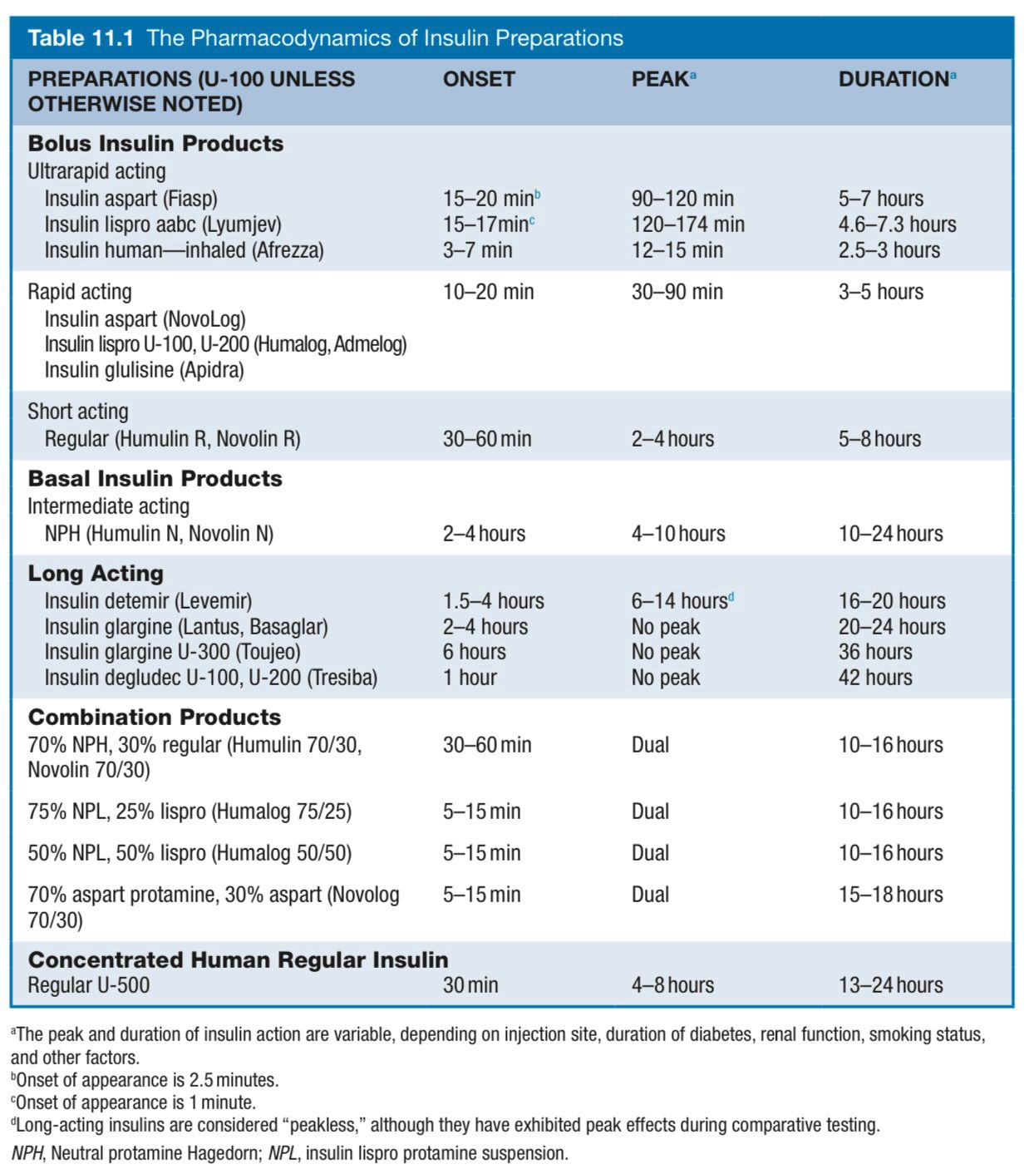

Slide 20
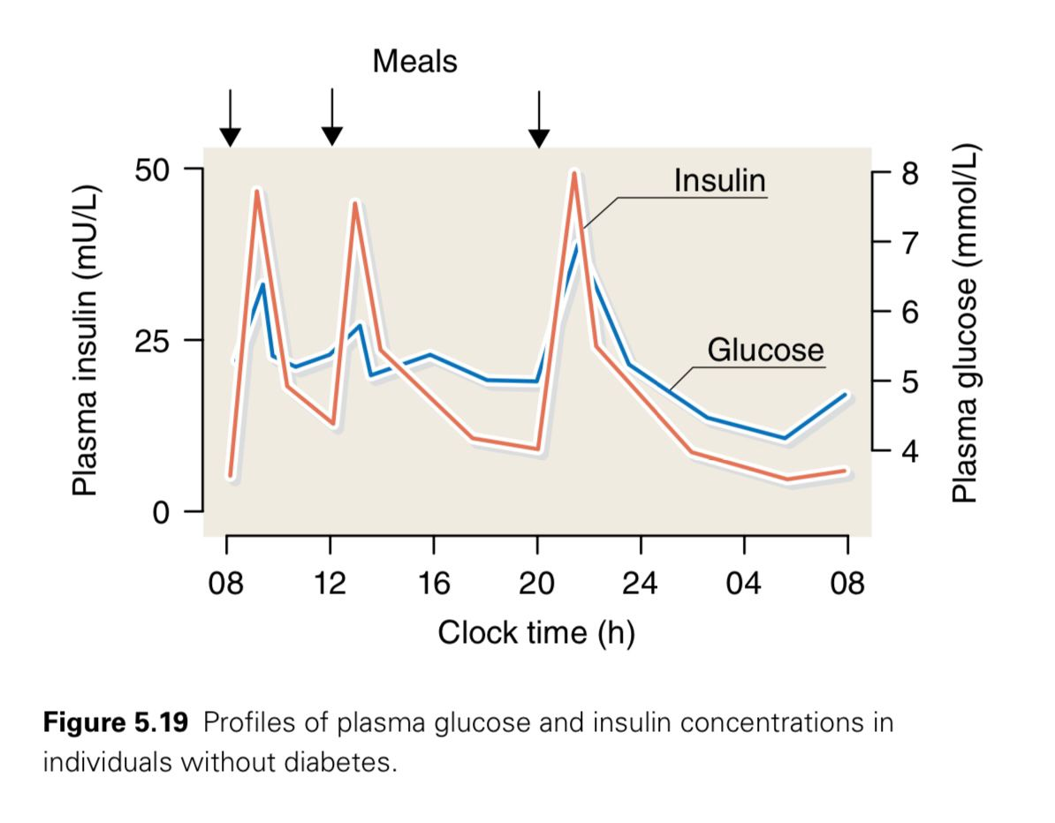
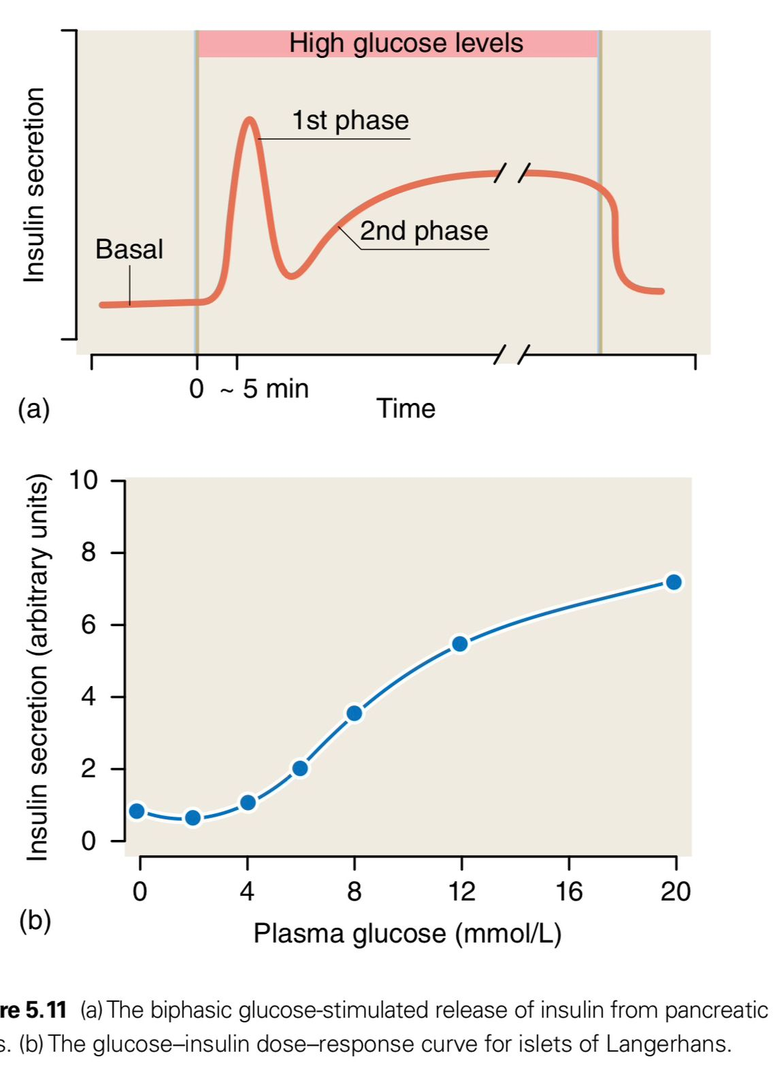
Quick Explanation of the normal physiology of insulin secretion
Quick Explanation of the normal physiology of insulin secretion

Slide 21
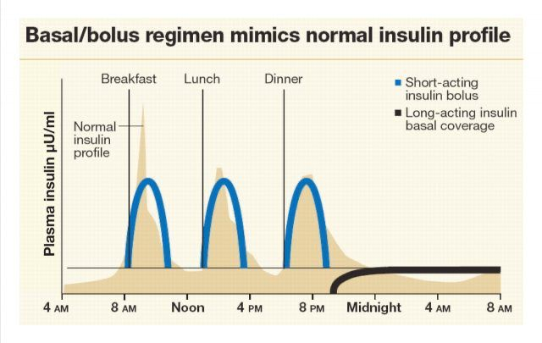
Basal/bolus regimen mimics normal insulin profile
Basal/bolus regimen mimics normal insulin profile
Normal insulin profile
Mimics of normal insulin profile

Slide 22
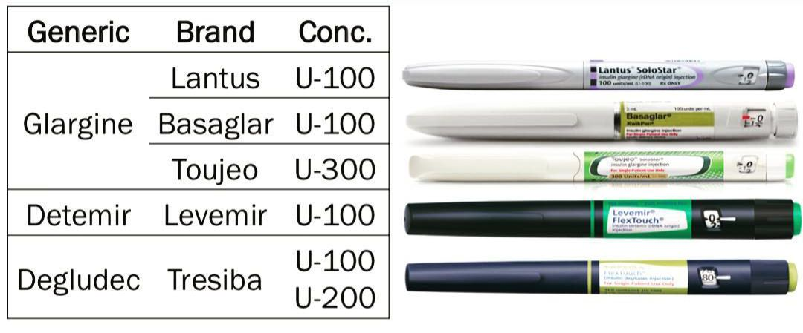
Basal insulin (Long Acting Insulin)
Basal insulin (Long Acting Insulin)

Slide 23
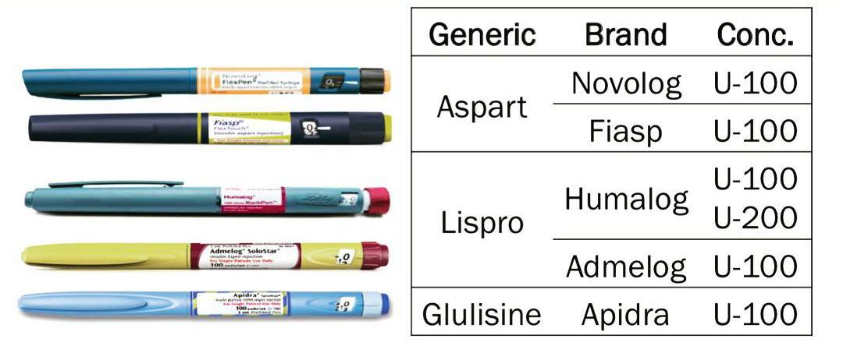
Bolus insulin (Rapid-Acting Insulin)
Bolus insulin (Rapid-Acting Insulin)

Slide 24
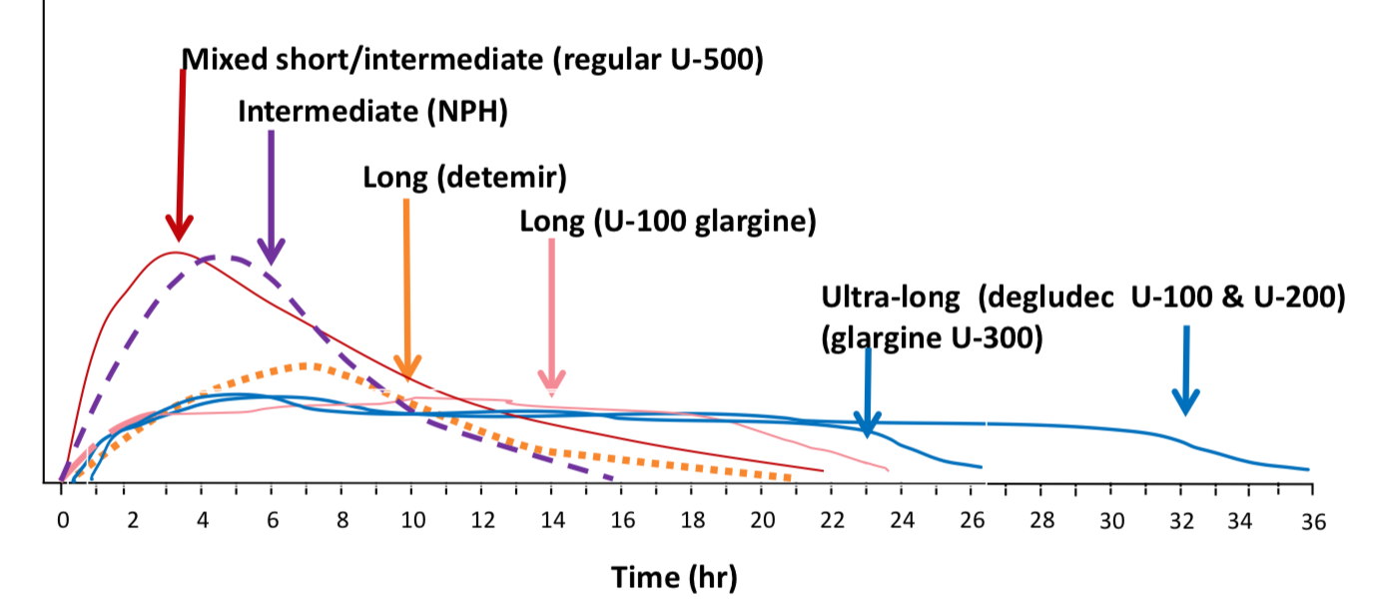
Bolus insulin (Rapid-Acting Insulin)
PHARMACOKINETICS - Basal
Approximate pharmacokinetic profiles of various types of insulins
Very important to note that pharmacokinetic data do not always predict clinical outcomes

Slide 25
Bolus insulin (Rapid-Acting Insulin)
PHARMACOKINETICS - Prandial
Very important to note that pharmacokinetic data do not always predict clinical outcomes

Slide 26
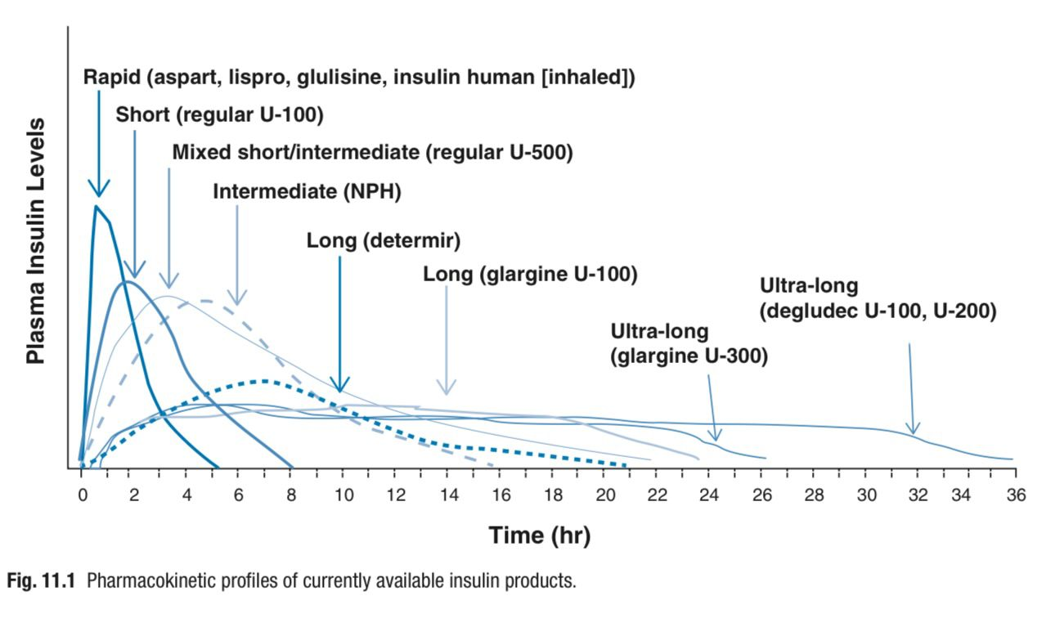
Basal vs. Prandial

Slide 27
PHARMACOKINETICS/PHARMACODYNAMICS
Factors affecting insulin absorption
Exercise of injected area (Within 1 hour of injection) | Local massage (vigorous rubbing/massaging) | Temperature (Heat can ↑)
Site of injection (Abdomen > other sites) | Lipohypertrophy (Delays absorption) | Mode of delivery (changes kinetics)
Insulin mixtures (unpredictable) | Physical status (Suspension insulins must be properly resuspended) | Dose of insulin

Slide 28
Insulin in T1D
T1D is caused by autoimmune destruction of the pancreatic beta cells, which leads to an absolute deficiency of insulin.
The mainstay of treatment of T1D is intensive insulin therapy (IIT).
IIT is the use of multiple daily injections (MDIs) of insulin (both basal and bolus formulations) or an insulin pump in an effort to mimic the normal physiologic secretion of insulin by the pancreas.
IIT may also be referred to as physiologic, multiple-component, or basal-bolus insulin therapy.

Slide 29
Insulin in T1D
A long-acting insulin is injected either once or twice daily to provide the basal insulin portion of an MDI regimen, which is approximately 50% of a patient’s total daily dose.
Ideally, basal insulin should cover background insulin needs only, independent of food intake.
A rapid, ultrarapid, or short-acting insulin is injected before meals to provide the bolus insulin portion of an MDI regimen.
Rapid-acting or ultra- rapid-acting insulin is preferred over short-acting insulin because of the more rapid onset and shorter duration of action.

Slide 30
Insulin in T1D
A patient can adjust each bolus dose to match the carbohydrate intake and to correct for high glucose levels before the meal.
The basal dose remains constant from day to day.
The starting dose in T1D is generally calculated based on weight, starting with a total daily insulin dose of 0.4 to 1.0 units/kg.
After calculating the TDD, approximately half is given as basal insulin, and the other half is given as bolus insulin, distributed across meals.
Insulin doses are then titrated based on BG monitoring data, and bolus doses can be further refined based on carbohydrate counting (ICR) and correctional dosing (ISF).

Slide 31
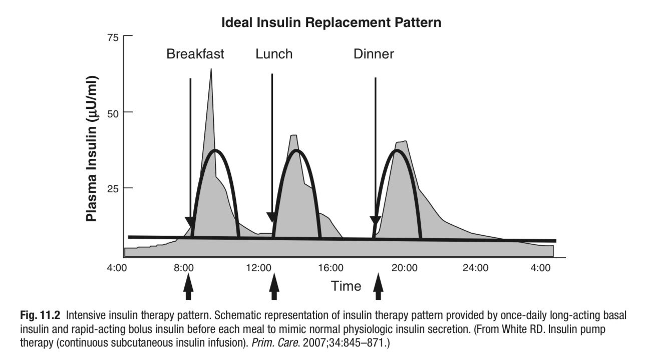

Slide 32
Insulin in T1D
Intensive insulin therapy is complex because it requires multiple injections or pump boluses per day in addition to basal insulin doses, routine monitoring, and collaborative decision making.
The most successful insulin therapy is adjusted based on:
Changes in nutritional intake
Glucose levels
Stress levels ( Exam Days!! )
Physical activity
Critical components include the use of SMBG or CGMs to identify glucose patterns and adjust insulin doses, ICR and ISF for the adjustment of insulin according to glucose levels.

Slide 33
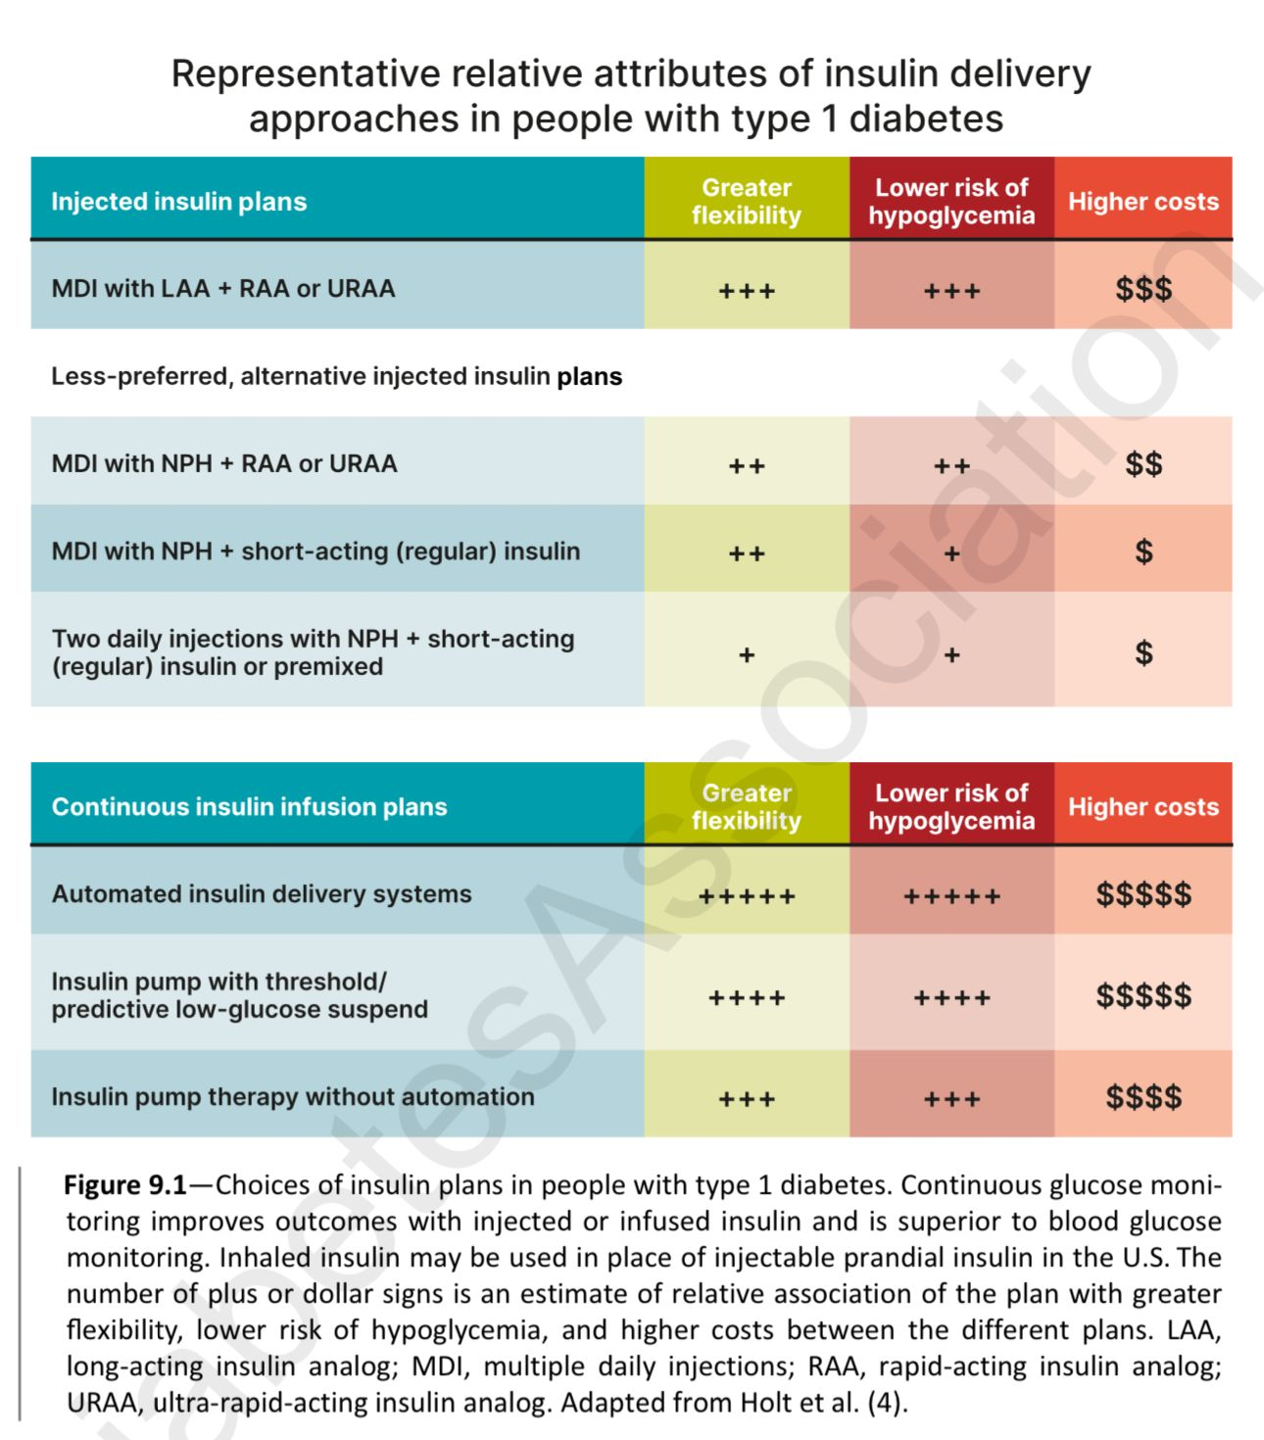
ADA 2025

Slide 34
Carbohydrate-to-insulin (C:I) ratio or ICR
The C:I ratio is an estimate of the grams of carbohydrate that will be covered by each 1 unit of insulin.
A C:I ratio of X:1 means that 1 unit of insulin should be given for each X grams of carbohydrate to be consumed.
The initial C:I ratio for each person is usually calculated as follows: 500/Total daily dose (TDD) of insulin.
The C:I ratio must then be evaluated and adjusted to achieve optimal pre-prandial to post-prandial blood glucose (BG) excursions
(optimal: 30 to 50 mg/dL rise from premeal to 2 hours post meal)

Slide 35
Carbohydrate-to-insulin (C:I) ratio or ICR
1.Preparation:
Before the test meal, make sure your glucose level is between 70-140 mg/dL. If it's below 70 mg/dl or above 140 mg/dl, don't proceed with the test.
Choose a meal with known carbs and low fat content (less than 20g of fat).
2. Testing Process:
Check your glucose level just before the test meal.
Take the insulin dose based on your C:I ratio.
Check your glucose level 2 hours after the meal.
Calculate the change in glucose levels from before to after the meal (glucose excursion).
3. Interpreting Results:
Aim for a glucose excursion of about 30-50 mg/dL.
If the rise in glucose is more than 50 mg/dL, consider adjusting your C:I ratio by increasing it.
If the rise is less than 30 mg/dL, consider adjusting your C:I ratio by decreasing it.

Slide 36
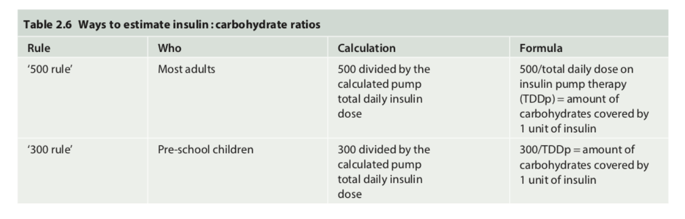

Slide 37
Insulin sensitivity factor (ISF)
The insulin sensitivity factor describes the predicted drop in blood glucose after 1 unit of insulin is given when BG is elevated above the goal.
We calculate an initial ISF as 1650/TDD
(some providers use 1800/TDD, 1700/TDD, or 1500/TDD).
The initial ISF must then be evaluated and adjusted to achieve appropriate reductions of high BG to the target range by 4 hours after the dose is given.

Slide 38
Practical section!
Ahmad has T1DM and manages this with MDIs as follows:
Basal insulin: 32 units daily
Bolus insulin: C:I ratio = 10:1, CF = 40:1, BG target = 100 mg/dL
Premeal BG = 180 mg/dL
Planned meal:
Tuna sandwich
Medium apple
Oreo cookies—2
Milk—1 cup
How many grams of carbohydrate does this meal contain?
How much insulin will be needed to cover the carbohydrates?
How much insulin will be needed to correct the premeal glucose?
What total dose of insulin should be taken?

Slide 39
Planned meal:
Tuna sandwich (30 g)
Medium apple (15 g)
Oreo cookies—2 (15 g)
Milk—1 cup (12 g)
How many grams of carbohydrate does this meal contain? 72 grams
How much insulin will be needed to cover the carbohydrates? 7 units
How much insulin will be needed to correct the premeal glucose? 2 units
What total dose of insulin should be taken? 9 units

Slide 40
Insulin in T2D
In Type 2 Diabetes (T2D), the approach to insulin usage differs from Type 1 Diabetes (T1D).
Patients with T2D can often manage their condition for years using non-insulin medications and lifestyle changes before requiring insulin.
However, due to the progressive nature of T2D, many individuals will eventually need insulin to control their blood sugar levels.
Current treatment guidelines recommend a stepwise approach.

Slide 41
Insulin in T2D
Recommended steps
Basal insulin
Bolus Insulin
GLP-1 RA or Dual GIP and GLP-1 RA

Slide 42
Insulin in T2D
Once injectable therapy is needed, Starting with a GLP-1 RA or dual GIP and GLP-1 RA is preferred over insulin because:
Comparable glucose-lowering effects
Lower risk of hypoglycemia
Preferred effect on weight
If further glucose control is needed after maximizing the use of a GLP-1 RA, the next step is typically adding basal insulin.
Subsequently, bolus insulin may be introduced in a stepwise manner if required, based on the individual's A1c levels and glucose profile.

Slide 43
Insulin in T2D
Early initiation of insulin therapy is preferred in patients with extremely elevated glucose levels:
A1c >10%
Random/ fasting Glucose ≥300 mg/dl
Evidence of ongoing catabolism
Symptoms of hyperglycemia
Although those patients may need insulin initially, they can likely transition from insulin to other medications once the acute hyperglycemia and glucotoxicity have resolved.

Slide 44
Insulin intensification in T2D
When a patient with T2D requires intensification to insulin therapy, basal insulin is typically the first step.
Basal insulin is added to the medication regimen at a starting dose of 10 units (or 0.1–0.2 units/kg) per day.
The dose is then up-titrated, typically by 2 to 4 units twice weekly, using a validated dose-titration method until FPG levels are within the target range (80 –130 mg/dL for patients with an A1c goal of <7%).
Dose titration should continue until FPG levels are reached or until the dose reaches approximately 0.5 units/kg/day.

Slide 45
Insulin intensification in T2D
If additional therapy is needed to achieve glycemic goals, prandial insulin can be added.
A bolus insulin product can be added to the largest meal or the meal leading to the largest glucose excursions, at a starting dose of 4 units.
The dose can then be titrated by 1 to 2 units twice weekly based on postprandial glucose levels.
A reasonable recommended target PPG level for most patients is <180 mg/dL.
Additional doses of bolus insulin can be added to the other meals if needed to achieve glycemic goals.

Slide 46
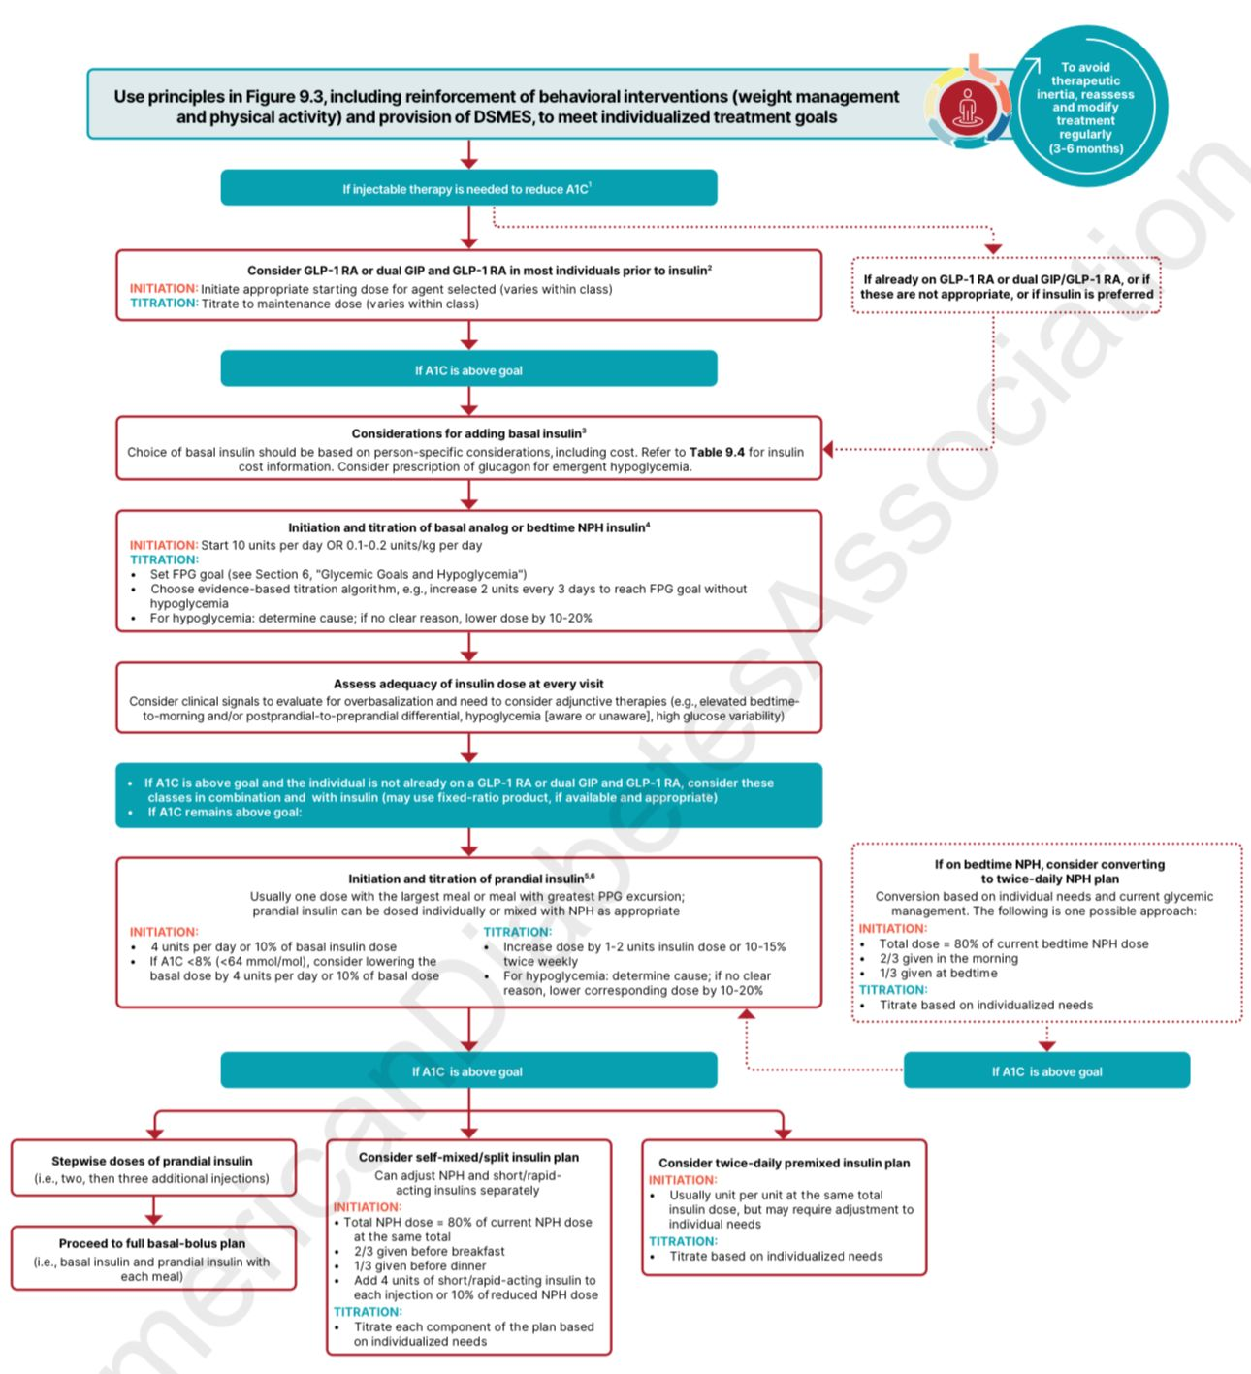
ADA 2025

Slide 47
Take rapid-acting insulin:
Rapid-acting insulin should be taken within 15 minutes before meals and snacks.
15-30 mins before meals if premeal blood sugar is over 130 mg/dL.
Immediately after eating if gastroparesis or a concurrent illness is present
Upon arrival of food if unfamiliar with meal size, content, or timing (i.e., in a restaurant or hospital)
Fast-acting insulin aspart (Fiasp) and insulin lispro-aabc (Lyumjev) should be taken at the beginning of the meal or within 20 minutes after starting the meal.
Inhaled insulin at meal beginning.
Regular insulin about 30 mins before meals.

Slide 48
Take basal insulin:
Insulin glargine U-100, detemir, glargine U-300, and degludec should be taken once a day at the same time each day.
Insulin glargine U-100 or detemir may be taken at bedtime if a dawn phenomenon is present.
Basal insulin analogs (glargine, detemir, or degludec) cannot be mixed with other insulins.
If nocturnal hypoglycemia results from taking a full dose of glargine or detemir at bedtime, an option would be to split the dose so that 50% is taken in the morning and the other 50% is taken in the evening, approximately 12 hours apart.
NPH insulin is given in the morning and at bedtime to avoid nocturnal hypoglycemia.
Doses of insulin glargine U-300 and insulin degludec should not be adjusted more frequently than every 3 to 4 days because of their longer half-lives.

Slide 49
Insulin Conversion Principles
Rapid-acting insulin analogs have similar PK/PD properties
Rapid-acting → Rapid/Ultra-rapid: 1:1 unit conversion
Basal insulins: 1:1 unit conversion (most cases)
Twice-daily NPH → Glargine (Gla-100 / Gla-300): Use 80% of total daily NPH to reduce hypoglycemia risk

Slide 50
Basal Insulin Conversion Principles
Once-daily NPH → Gla-100 / Gla-300: 1:1 unit conversion
Detemir (IDet) → Gla-100: May require higher TDD (esp. if BID IDet)
Gla-100 (Lantus) → Gla-300: ↑ dose by ~10–18%
Gla-300 (Toujeo) → Gla-100: ↓ dose by ~20%

Slide 51

Conversion between Basal insulin
Exceptions to 1:1 conversion are:
Insulin glargine U-100/ U-200
Insulin glargine U-300
BID NPH to once daily
Insulin detemir U-100
“This recommendation does not replace clinical judgement based on patient’s presentation or patient-specific factors”

Slide 52
Insulin Injection Technique
Prime pen with 2 units before each injection → ensures accurate dosing (displace air)
Hold needle in place → prevents up to 20% dose loss
Injection sites (subcutaneous only)
Abdomen (preferred)
Thighs / Buttocks / Upper arms
Avoid intramuscular injections (↑ hypoglycemia risk)
Rotate sites within the same region, ≥2–3 cm apart, to prevent lipohypertrophy

Slide 53
Which of the following factors should be considered when choosing insulin therapy for a patient with diabetes?
  Dose of insulin needed
  Cost
  Ease of administration (vials versus pens)
  Frequency
  All of the above

Slide 54
A 56-year-old man with T2DM is on metformin ER 2000 mg daily, insulin glargine U-300 at 50 units daily, and liraglutide 1.8 mg daily. His A1C is at goal of <7% with no hypoglycemia. Fasting and postprandial BG values are in range. Glargine U-300 is now out of stock and patient is being switched to insulin glargine U-100. What dose of insulin glargine U-100 do you recommend?
  50 units as there is a 1:1 conversion
  40 units as glargine U-100 is more potent than glargine U-300
  60 units as glargine U-100 is less potent that glargine U-300
  None of the above is correct

Slide 55
Key Points to Remember!
The impact of insulin products on glucose profiles is determined by their (PK/PD) profiles.
T1D: Typically requires intensive insulin therapy, either through multiple daily injections or an insulin pump
T2D: Insulin is added progressively when non-insulin medications fail to achieve glycemic targets.
Common Side Effects: These include hypoglycemia, weight gain, injection-site reactions, and lipohypertrophy; education is crucial for management.
Considerations for Insulin Selection: Factors include diabetes type (T1D vs. T2D), PK/PD properties, total insulin needs, insulin resistance, injection frequency, and cost.

Slide 56
References
Insulin Pumps and Continuous Glucose Monitoring Made Easy 2017.
Anderson SL, Trujillo JM, Anderson JE, Tanenberg RJ. Switching basal insulins in type 2 diabetes: practical recommendations for health care providers. Postgrad Med. 2018;130(2):229–238.
Patel D, Triplett C, Trujillo J. Appropriate titration of basal insulin in type 2 diabetes and the potential role of the pharmacist. Adv Ther.2019;36:1031–1051.
American Diabetes Association. 9. Pharmacologic approaches to glycemic treatment: Standards of medical care in diabetes – 2025. Diabetes Care.

Slide 57


